Slide 1
Mathematical Game Analysis and Optimization

Slide 2
Motivation
Optimize and understand player decisions
Found other people’s work, but it wasn’t trying to be exact
Keep discovering really interesting solutions and techniques
Fun!

Slide 3
History of Models
20-year-old game
Combat mechanics are particularly interesting
[Show fighting clip]
Health, Max hit, Accuracy

Slide 4
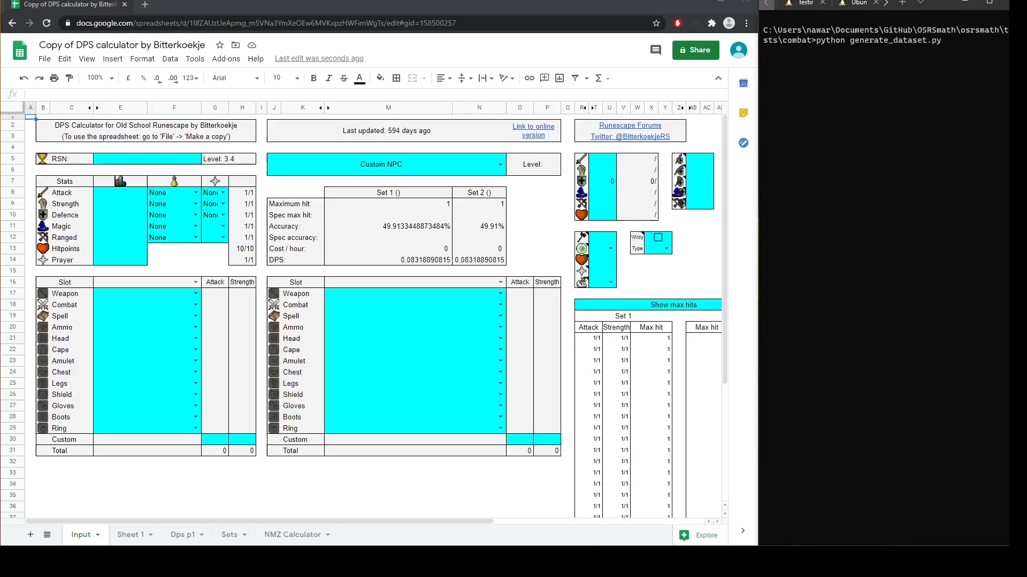
History of Models

Slide 5


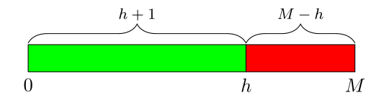

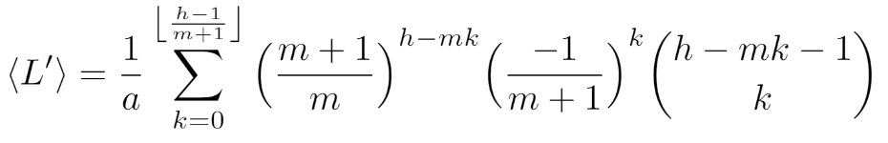
History of Models
Crude
Overkill
Recursive
Markov Chain
Notes:
Peicewise average vs peicewise. Recursive needs approximation.
Show recursive solution

Slide 6
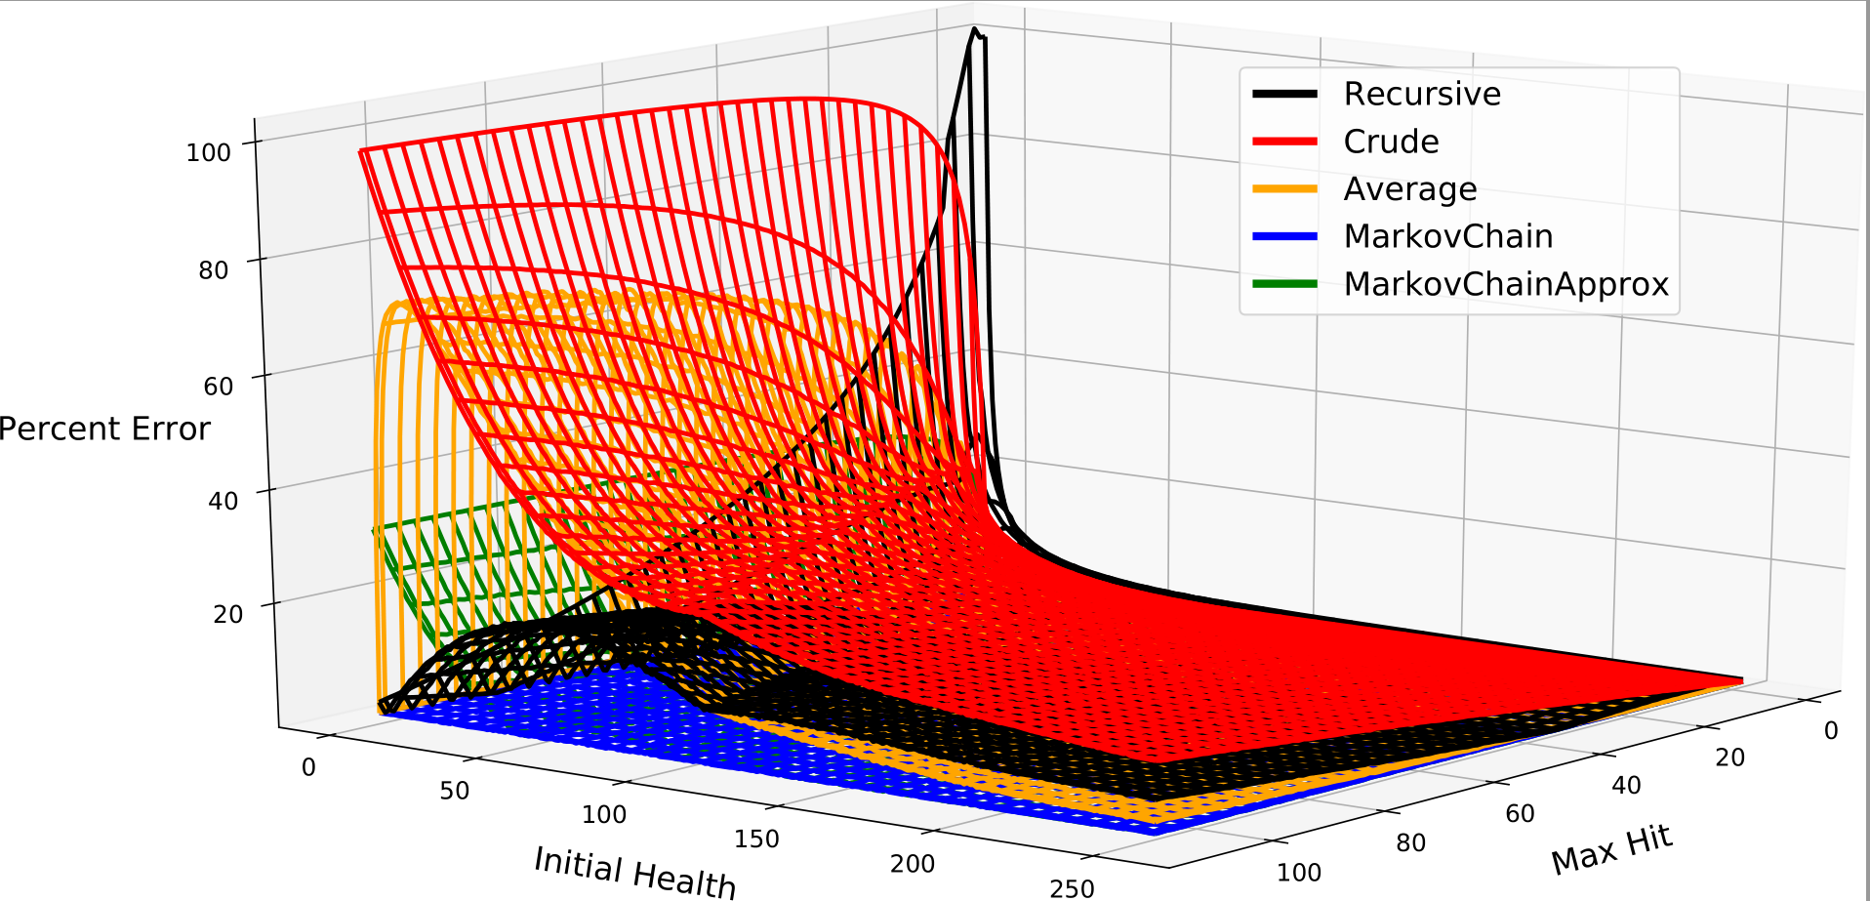
Comparison of Models

Slide 7
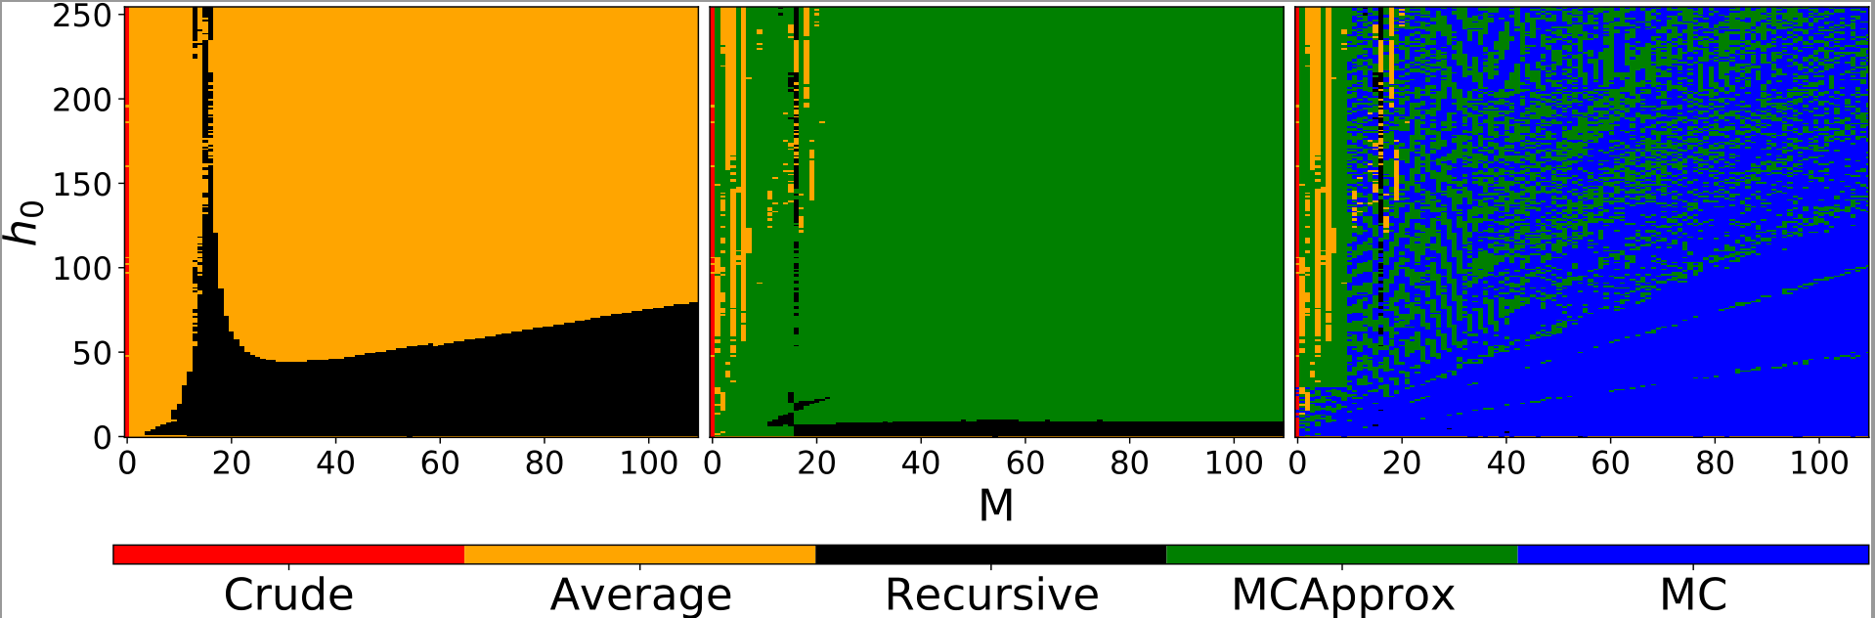
Comparison of Models

Slide 8
Comparison of Models
Markov is analytically exact!
But only average is computed, what about other statistics?
  Confidence Interval
  Variance
  Probability of winning
Need ! [Go to solution]

Slide 9
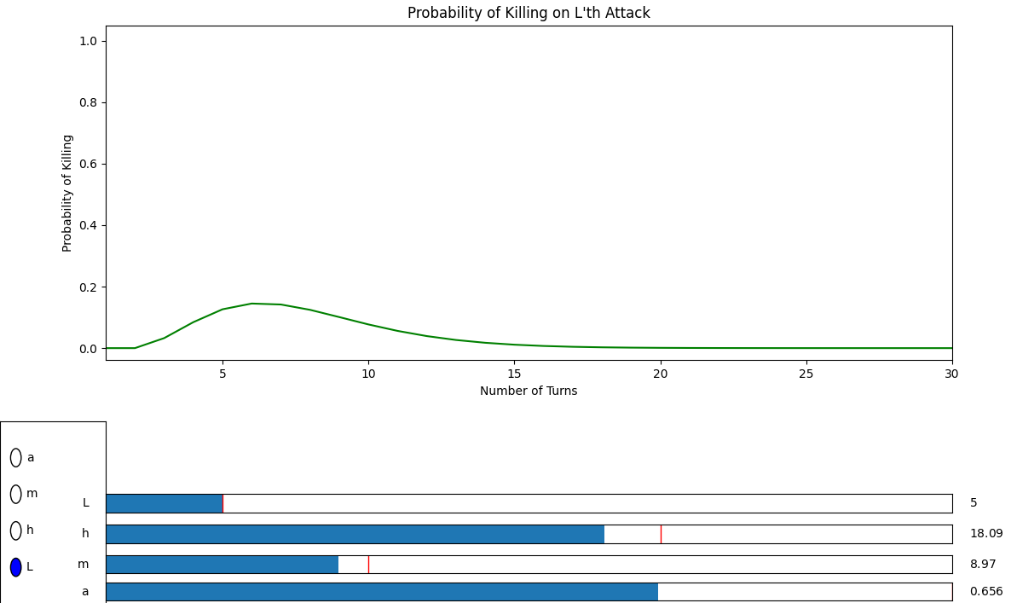
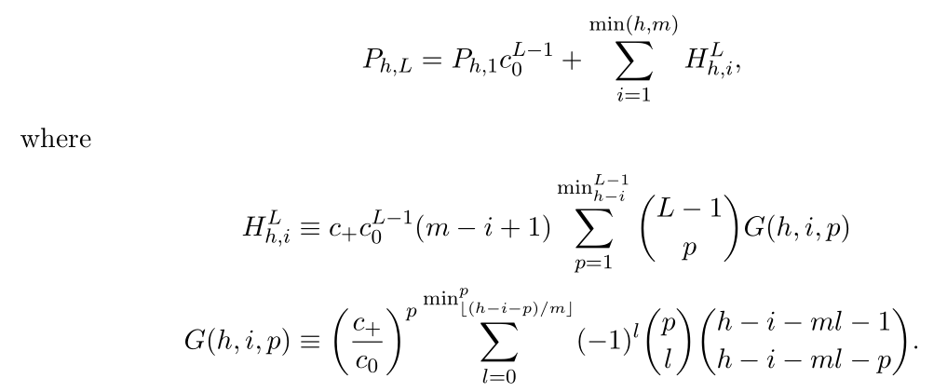
Markov Chain Distribution

Slide 10
Markov Chain Distribution

Slide 11
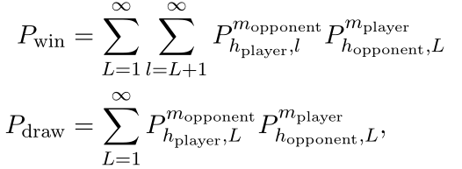
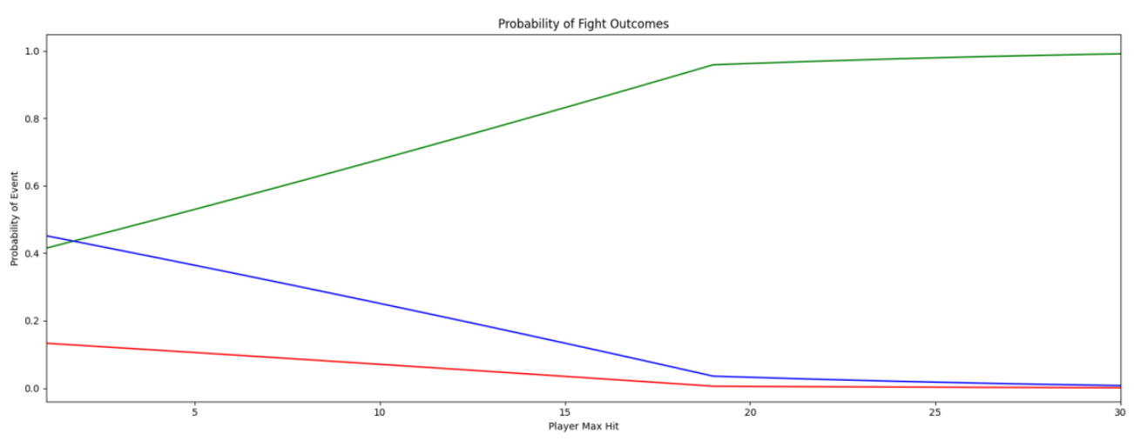
Probability of winning

Slide 12
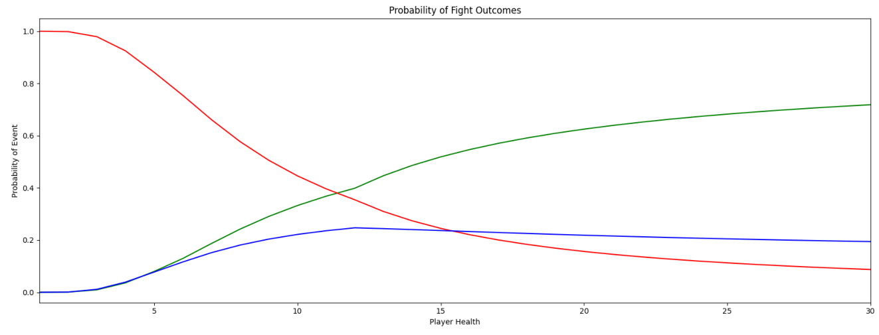
Probability of winning

Slide 13
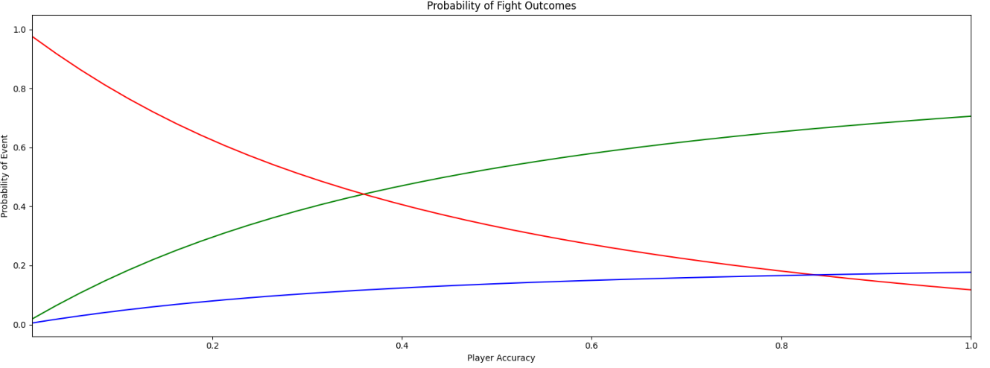
Probability of winning

Slide 14
Generalizing Markov Chain Solution
can generalize to any distribution: Multiple opponents/attacks
  Also negative/healing: -, 0, +
What I’m calling “Filling problem”
Probability of filling something after N samples from a distribution:
  Couldn’t think of many examples: Parking lot
  Has this been done before? Seems pretty general

Slide 15
So far…
Take player/opponent equipment/levels & calculate .
Take & calculate probability of killing in L turns, exactly
  Average, variance, confidence intervals, …
Take and and calculate P_win, P_lose, P_draw

Slide 16
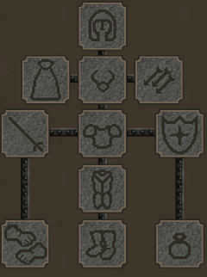
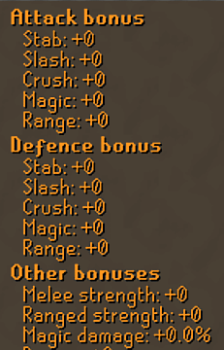
Optimal Player Decisions: Equipment
Equipment Slots
11 equipment slots & 100s of items leads to at least 10^9 combinations. How to pick best equipment?
Search space reduction!
  Project down vector of bonuses
  Define “Not worse than everything” operator
  Reduces sets to ~250, <<1000.
Easy brute force determines optimal loadout
[Show app]
Equipment Bonuses
Notes:
For whatever optimization problem, define a projection vector that selects relevant bonuses – simplifies considerations

Slide 17
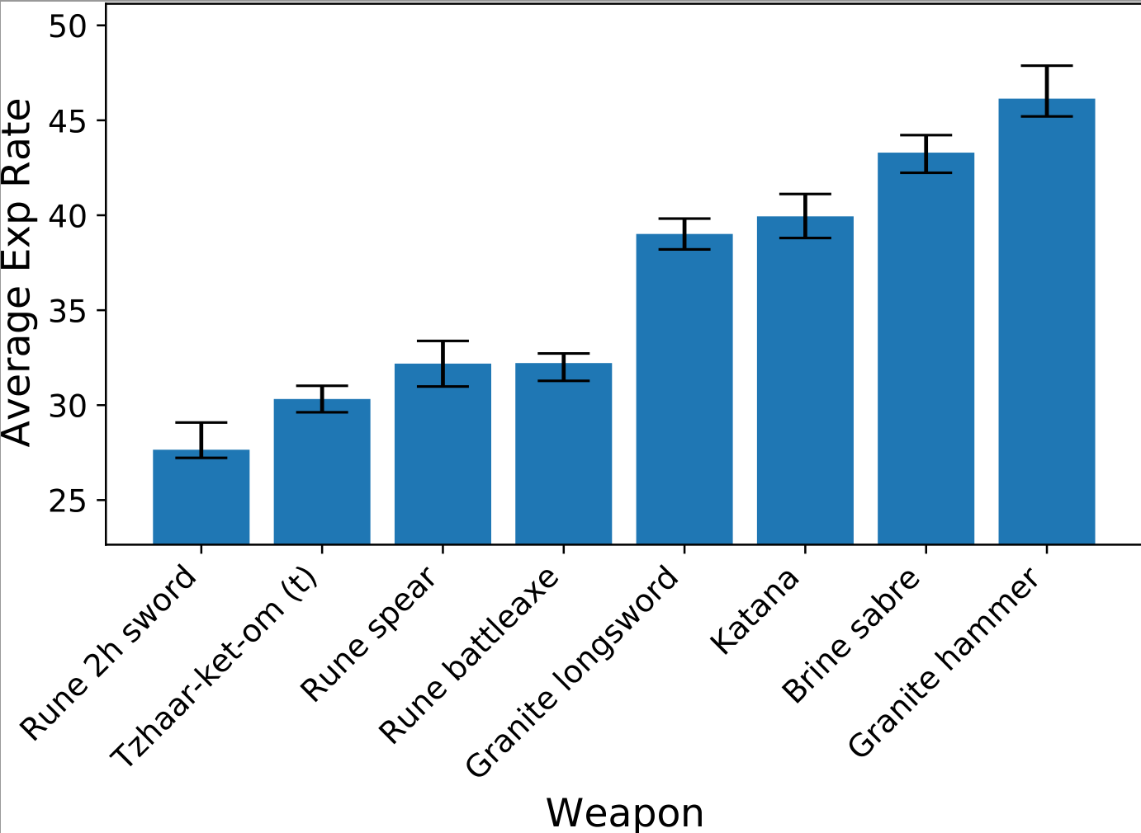
Optimal Player Decisions: Equipment
Notes:
For whatever optimization problem, define a projection vector that selects relevant bonuses – simplifies considerations

Slide 18
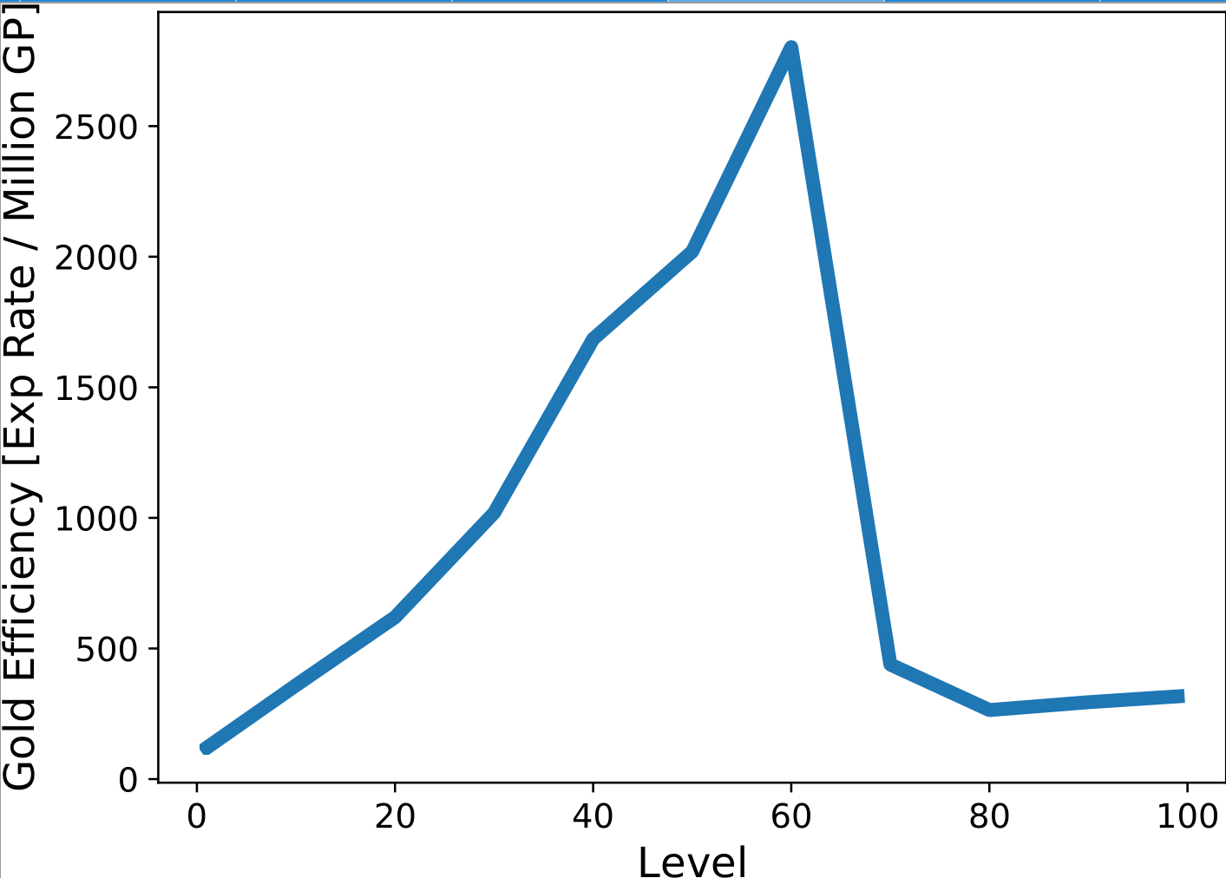
Optimal Player Decisions: Equipment
Notes:
For whatever optimization problem, define a projection vector that selects relevant bonuses – simplifies considerations

Slide 19
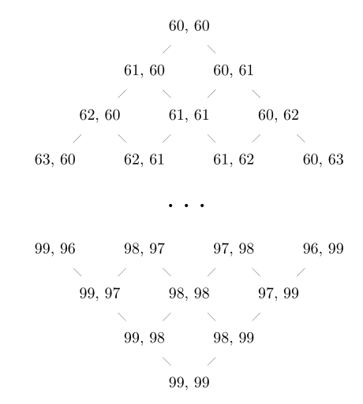
Optimal Player Decisions: Training Order
Three Skills:
  Attack Accuracy
  Strength Max Hit
  Defence Better equipment
Starting at level (1, 1, 1), what to train first? And so on

Slide 20
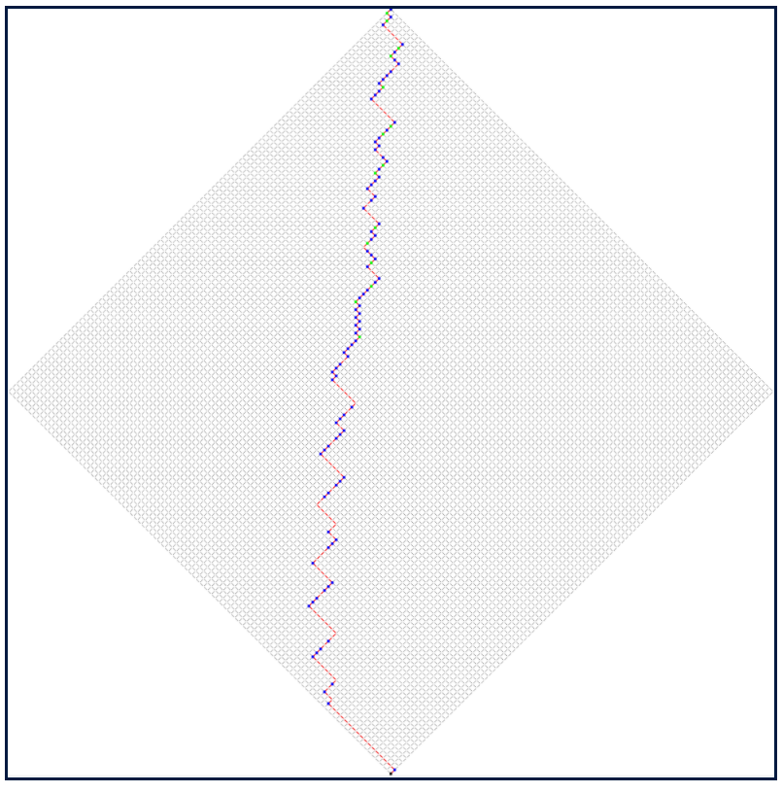
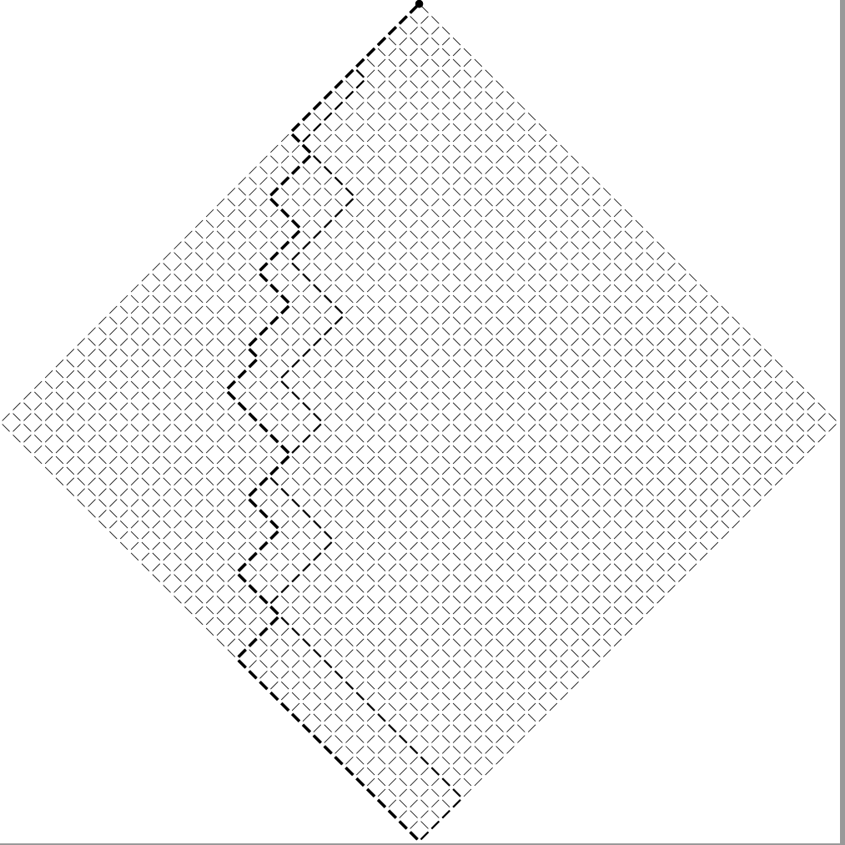
Optimal Player Decisions: Training Order

Slide 21
Optimal Player Decisions: Training Order
Strength is more important!
~10% higher is optimal
This is what most players find

Slide 22
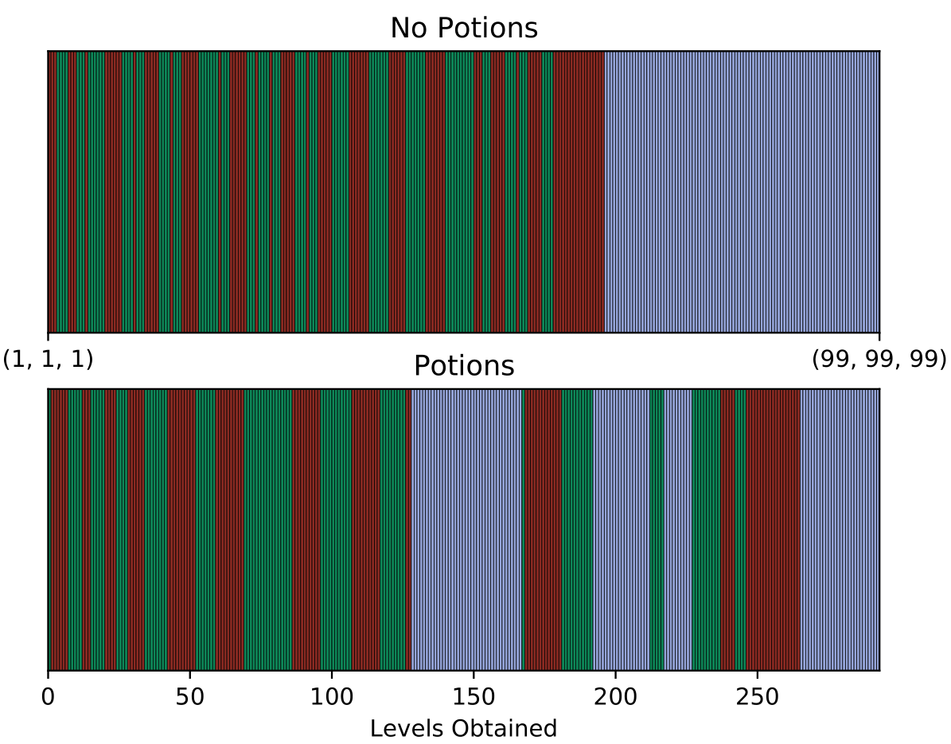
Optimal Player Decisions: Training Order
Can now find mathematically exact solution to optimal training order!
Even providing schemes

Slide 23
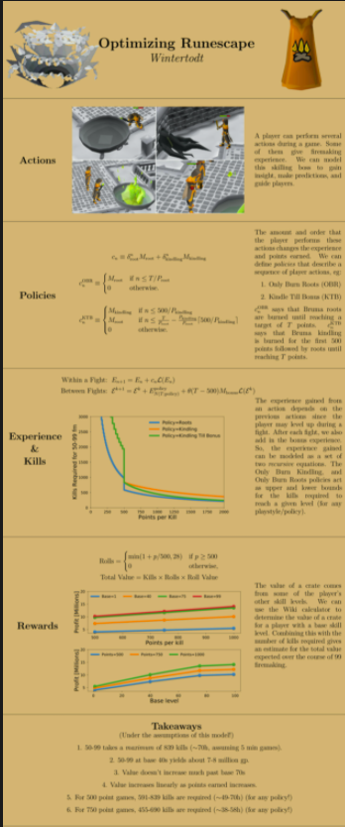
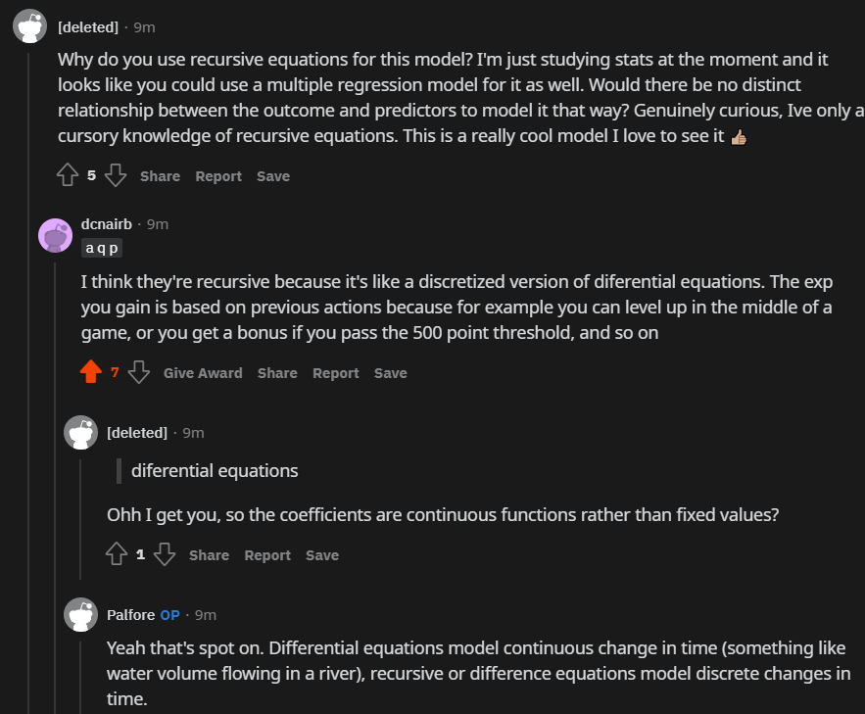

Slide 24
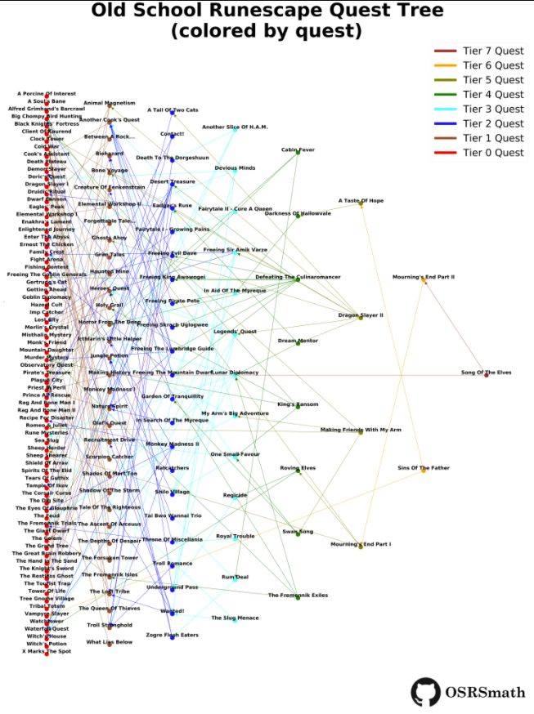
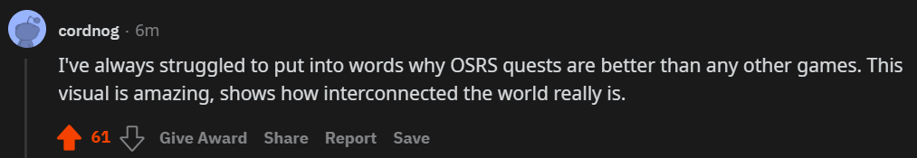
Quest Tree

Slide 25
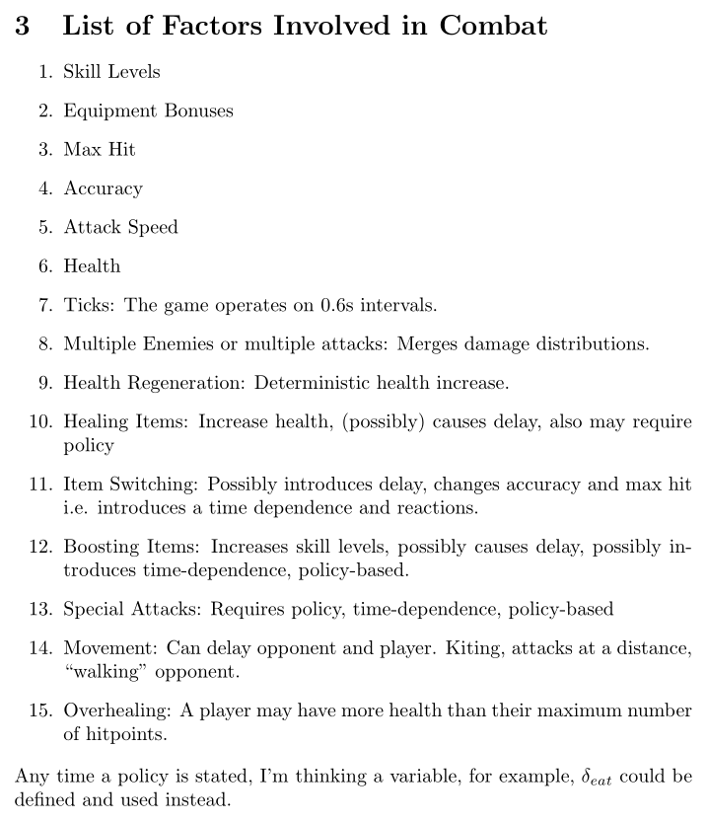
Future Work
Add additional complexities
Find optimal strategies for switching items, healing, moving, boosting, special attacks
Evolve neural network / genetic algorithm fighters
Compare to historical game play, highscores, modern strategies

